Slide 1

8086 Assembly
Problem Set 3

Slide 2


Important Notes
Print a String
Define The String and It Must End With $
Load The String Location
Call The Interrupt

Slide 3
Important Notes
Input a String
Define The Buffer and It Must Start With Buffer Size Byte then Empty Byte
Buffer Size
Buffer Itself
Interrupt will put input
string length here

Slide 4


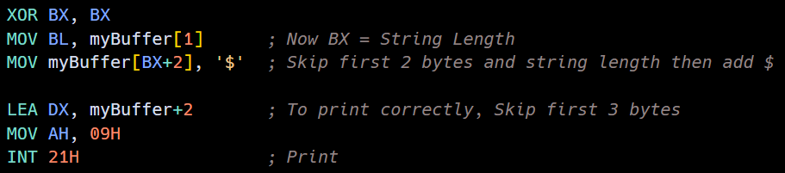
Important Notes
Input a String – Cont.
Load The Buffer Location
Call The Interrupt
Note: This Buffer Can’t Be Printed as It Doesn’t Have $
Add $ After Input String Using Input Length Byte

Slide 5
Important Notes
String To Decimal
X = 0
Loop on String From MSB Taking Character Y
[Y as Decimal] = [Y as Char] – [“0” Char (30h)]
X = X * 10 + Y
Now We Have Decimal in X
Decimal To String
X = number, Y = next character to write
Loop Until No Remainder [Writing from Right (LSB)]
[Y next Char] = [X % 10] + [“0” Char (30h)]
X = X / 10 (Integer Division)

Slide 6



Important Notes
ASCII-Coded BCD
(also called packed BCD)
Value
BCD
No Restrictions
One Nibble (4 bits)
One Byte (8 bits)
As ASCII is one byte
Instructions: DAA - DAS
Instructions: AAA – AAS
AAM - AAD

Slide 7
Important Notes
Take Input String as Binary
X = 0
Loop on String From MSB Taking Character Y
If Y == ‘1’
ORR X, 1
SHL X,1
Now We Have Same Value in X
Convert Digit to HEX ASCII
X = Digit
X = X + ‘0’
IF X > ‘9’: X = X + 7 (according to ASCII table)

Slide 8
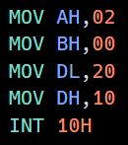
Problem 1
What is the function of the following program?

Slide 9
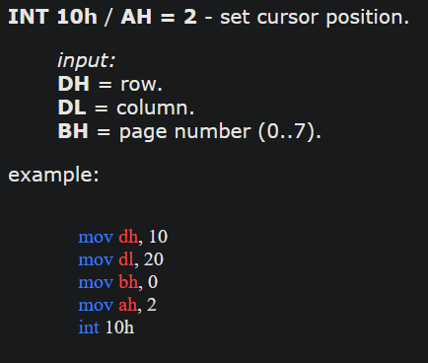
Problem 1
What is the function of the following program?
In text mode: the screen is 80 columns and 25 rows (80 x 25)

Slide 10
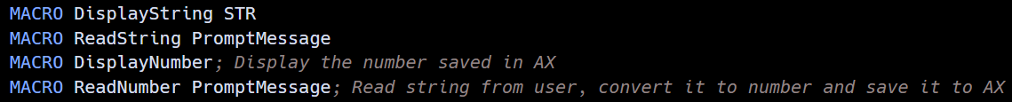
Problem 2
Make a file for macros that contains the following macros
Code

Slide 11
Problem 3
Use internet search to find the function of the following assembly commands:
DAA, DAS, AAA, AAS, AAM and AAD. Write a simple code describing each one.
Code

Slide 12
Problem 4
Colour Code
Black Problems are not solved
Yellow Problems are solved and important (have math)
White Problems are solved but have no math (interrupts only)

Slide 13
Problem 4
Code
Write the following programs
Clears the screen and puts the cursor on position row = 15 and column = 20, displays the prompt "What is your name?", gets a response from the keyboard and displays it at row = 17 and column = 20.
Input two seven-digit numbers in response to the prompts "Enter the first number" and "Enter the second number". Add them together (using AAA) and display the sum with the message "The total sum is:”
Accept 3 decimal digits from the KB, each digit is echoed to the display. Assuming the 3 digits represent a decimal number between 0-999, convert this number to binary and display the result.

Slide 14
Problem 4
Code
Write the following programs
Accepts a binary number (one byte) from the keyboard and echo it to the display in a hex-decimal form.
Displays the system time and the current day of the week at the upper right corner of the screen. Use the function 2CH, INT 21h to read the system time and the function 2AH, INT 21h to read the system date. The day should be displayed by its name and not its number.
Saves the contents of the current screen in a portion of the data segment, clears the screen, and then restores the contents of the screen if a key is pressed.

Slide 15
Problem 4
Code
Write the following programs
Draws a vertical line in the middle of the screen, then draw a horizontal line across the middle of the screen.
Draw a square, a rectangle and a triangle using three different colors. Screen background should be white.
Counts upward by increments of 1 and displays the count with a l-second delay in between counting. When any key is pressed, it stops counting. The initial count entered by user.

Slide 16
Problem 5
Code
Write a program that performs the following
Save the video mode and change it to one of the graphics modes
Ask the user to press the left button several times
Upon pressing any key, restore the original video mode and display the number when a key is pressed

